Slide 1
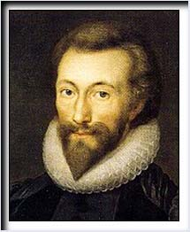
John Donne

Slide 2
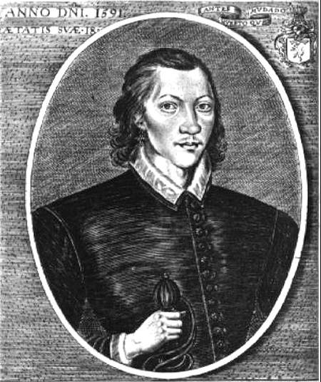
Life
John Donne (1572 - 1631), the founder of the metaphysical school of poetry and the greatest representative of the metaphysical poets, was born of a family with a strong Roman Catholic tradition. He was educated at the Trinity College, Cambridge.

Slide 3
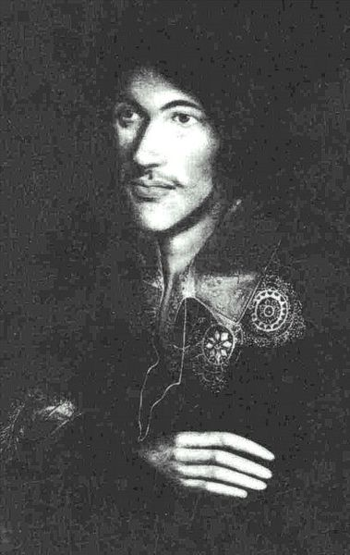
Life
As a young man hungry for adventures, he went with Essex on the expedition to Cadiz in 1596 and later became secretary to Lord Keeper Egerton. In 1601 he eloped with the niece of Lord Keeper and was imprisoned by the girl's father. For several years after his release, he lived in poverty. But during this time he wrote some of his most beautiful poems, many of which were believed to have been written to his wife. These were known as his youthful love lyrics.

Slide 4
So Much Death and Poverty…
Married in 1601, had 12 children (5 died early aged)
His wife died in 1617; he never remarried
In a state of despair, Donne noted that the death of a child would mean one less mouth to feed, but he could not afford the burial expenses

Slide 5
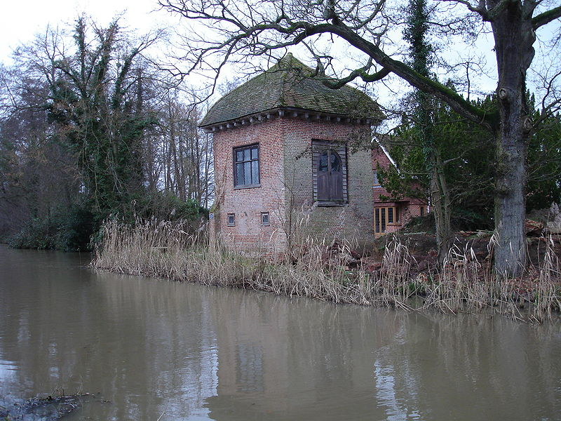
John Donne’s House
In 1615 he gave up Catholic faith and entered the Anglican Church and soon became Dean of Saint Paul's Church. As the most famous preacher during the time, he wrote many religious sermons and poems. And these were known as his sacred verses.

Slide 6
John Donne (1572-1631)
Roman Catholic in a Protestant England
Studied at Cambridge and Oxford
Imprisoned for marrying Anne More, his employer’s 16 year old niece.
1615 becomes Anglican priest
Scientific mind: Post-Copernican man of intellect
Dominant figure of a school of 17th century English writers known as the metaphysical poets.

Slide 7
Metaphysical Poetry
As one of the first modern writers, the construction of a historical self becomes crucial to the texts and their interpretation.
implies a highly intellectual approach to poetry
Relied on scientific ideas
Metaphysical concerns are the common subject of their poetry, which investigates the world by rational discussion of its phenomena rather than by intuition or mysticism.

Slide 8
The Holy Sonnets
None were published during Donne's life and they were known only by a small circle.
No manuscripts in Donne's hand exist today: scholars have only numerous, differing versions transcribed by others to work with.
Helen Gardner writes, "The image of a soul in meditation which the Holy Sonnets present is an image of a soul working out its salvation in fear and trembling."

Slide 9
The Holy Sonnets
Biographer R.C. Bald: “Donne's sonnets were the ruminations of a man in spiritual crisis, the product of his innate melancholy temperament, his reduced circumstances and lack of direction in his professional life.”
The Donne of the Holy Sonnets wrestles with questions about faith, God's mercy and judgment, human mortality and the immortality of the soul, sin, damnation, absolution and salvation.

Slide 10
The Holy Sonnets
Donne expresses despair about his own salvation, and reveals his fear of death.
The Holy Sonnets are the product of a doubter, one who has not yet found inner peace.

Slide 11
Culture and Thoughts
The Renaissance
The Renaissance began in the 13th century and reached its peak at the 16th century in Europe. People ‘s thoughts ventured away from the restriction of feudal belief of god and religion, and became more realistic and human. This was a great emancipation, which led to the works by people such as Francis Bacon and Shakespeare.

Slide 12
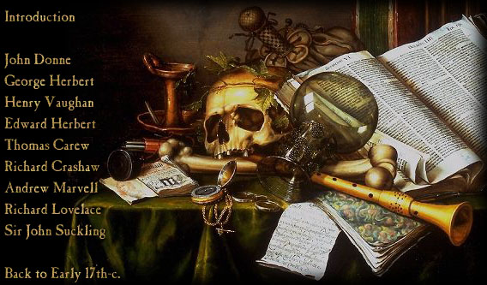
Renaissance Scholar’s Reading Desk

Slide 13
Holy Sonnet: 14 -------BY JOHN DONNE
Batter my heart, three-person'd God, for you
As yet but knock, breathe, shine, and seek to mend;
That I may rise and stand, o'erthrow me, and bend
Your force to break, blow, burn, and make me new.
I, like an usurp'd town to another due,
Labor to admit you, but oh, to no end;
Reason, your viceroy in me, me should defend,
But is captiv'd, and proves weak or untrue.
Yet dearly I love you, and would be lov'd fain,
But am betroth'd unto your enemy;
Divorce me, untie or break that knot again,
Take me to you, imprison me, for I,
Except you enthrall me, never shall be free,
Nor ever chaste, except you ravish me.

Slide 14
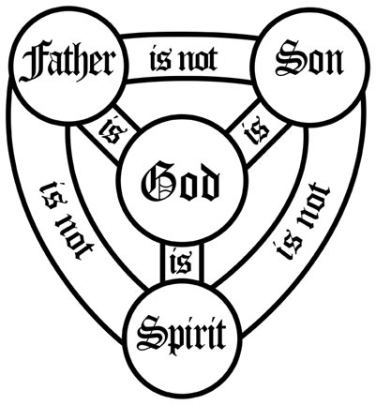
The Holy Trinity

Slide 15
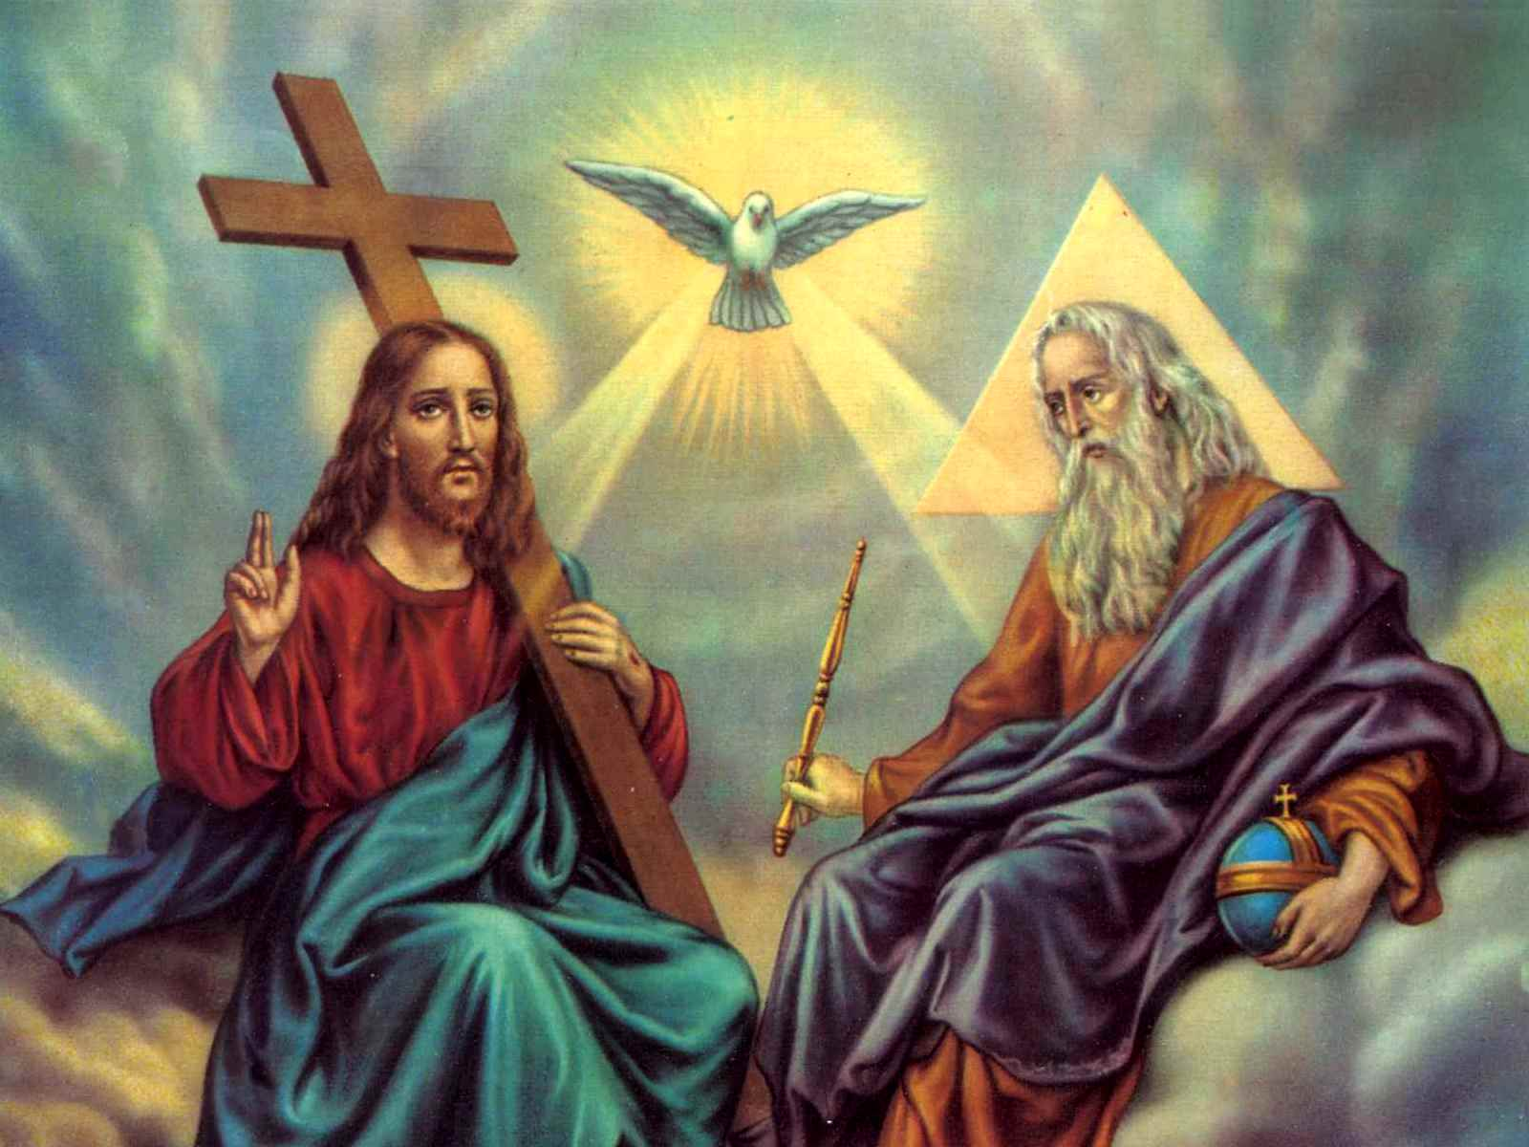

Slide 16
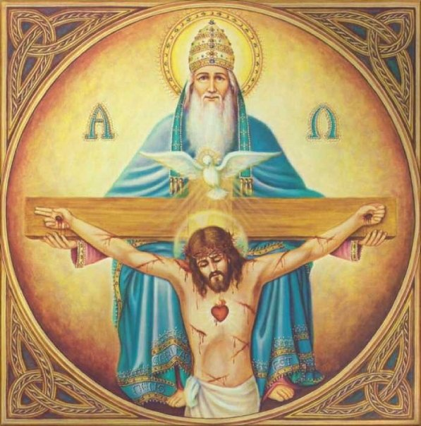

Slide 17
Holy Sonnet: 14 -------BY JOHN DONNE
Batter my heart, three-person'd God, for you
As yet but knock, breathe, shine, and seek to mend;
That I may rise and stand, o'erthrow me, and bend
Your force to break, blow, burn, and make me new.
I, like an usurp'd town to another due,
Labor to admit you, but oh, to no end;
Reason, your viceroy in me, me should defend,
But is captiv'd, and proves weak or untrue.
Yet dearly I love you, and would be lov'd fain,
But am betroth'd unto your enemy;
Divorce me, untie or break that knot again,
Take me to you, imprison me, for I,
Except you enthrall me, never shall be free,
Nor ever chaste, except you ravish me.

Slide 18
Holy Sonnet: 14 -------BY JOHN DONNE
Batter my heart, three-person'd God, for you
As yet but knock, breathe, shine, and seek to mend;
That I may rise and stand, o'erthrow me, and bend
Your force to break, blow, burn, and make me new.
I, like an usurp'd town to another due,
Labor to admit you, but oh, to no end;
Reason, your viceroy in me, me should defend,
But is captiv'd, and proves weak or untrue.
Yet dearly I love you, and would be lov'd fain,
But am betroth'd unto your enemy;
Divorce me, untie or break that knot again,
Take me to you, imprison me, for I,
Except you enthrall me, never shall be free,
Nor ever chaste, except you ravish me.

Slide 19
Holy Sonnet: 14 -------BY JOHN DONNE
Batter my heart, three-person'd God, for you
As yet but knock, breathe, shine, and seek to mend;
That I may rise and stand, o'erthrow me, and bend
Your force to break, blow, burn, and make me new.
I, like an usurp'd town to another due,
Labor to admit you, but oh, to no end;
Reason, your viceroy in me, me should defend,
But is captiv'd, and proves weak or untrue.
Yet dearly I love you, and would be lov'd fain,
But am betroth'd unto your enemy;
Divorce me, untie or break that knot again,
Take me to you, imprison me, for I,
Except you enthrall me, never shall be free,
Nor ever chaste, except you ravish me.

Slide 20
Hamlet:
How weary, stale, flat and unprofitable,
Seem to me all the uses of this world!
Fie on't! ah fie! 'tis an unweeded garden,
That grows to seed; things rank and gross in nature
Possess it merely.
…
As if increase of appetite had grown
By what it fed on

Slide 21
Sonnet 129
The expense of spirit in a waste of shame
Is lust in action: and till action, lust
Is perjur'd, murderous, bloody, full of blame,
Savage, extreme, rude, cruel, not to trust;
Enjoy'd no sooner but despised straight;
Past reason hunted; and no sooner had,
Past reason hated, as a swallow'd bait,
On purpose laid to make the taker mad:
Mad in pursuit and in possession so;
Had, having, and in quest to have, extreme;
A bliss in proof,— and prov'd, a very woe;
Before, a joy propos'd; behind a dream.
All this the world well knows; yet none knows well
To shun the heaven that leads men to this hell.
--Shakespeare

Slide 22
Signs are taken for wonders. “We would see a sign”:
The word within a word, unable to speak a word,
Swaddled with darkness.
In the juvescence of the year
Came Christ the tiger
In depraved May, dogwood and chestnut, flowering judas,
…
I that was near your heart was removed therefrom
To lose beauty in terror, terror in inquisition.
I have lost my passion: why should I need to keep it
Since what is kept must be adulterated?
I have lost my sight, smell, hearing, taste and touch:
How should I use it for your closer contact?

Slide 23
Holy Sonnet: 14 -------BY JOHN DONNE
Batter my heart, three-person'd God, for you
As yet but knock, breathe, shine, and seek to mend;
That I may rise and stand, o'erthrow me, and bend
Your force to break, blow, burn, and make me new.
I, like an usurp'd town to another due,
Labor to admit you, but oh, to no end;
Reason, your viceroy in me, me should defend,
But is captiv'd, and proves weak or untrue.
Yet dearly I love you, and would be lov'd fain,
But am betroth'd unto your enemy;
Divorce me, untie or break that knot again,
Take me to you, imprison me, for I,
Except you enthrall me, never shall be free,
Nor ever chaste, except you ravish me.

Slide 24
“From a perverted act of will, desire had grown, and when desire is given satisfaction, habit is forged; and when habit passes unresisted, a compulsive urge sets in.” Saint Augustine

Slide 25


