Slide 1
English Idioms and Phrases

Slide 2
A Bird In The Hand Is Worth Two In The Bush: Having something that is certain is much better than taking a risk for more, because chances are you might lose everything.
A Blessing In Disguise: Something good that isn't recognized at first.
Actions Speak Louder Than Words: It's better to actually do something than just talk about it.
To add fuel to the flames:
to excite the fury
Rome Was Not Built In One Day: If you want something to be completely properly, then its going to take time

Slide 3
To back the wrong horse:
to help a wrong person
To bark at the moon:
to rail uselessly at men in high places
All Greek to me: Meaningless and incomprehensible like someone who cannot read, speak, or understand any of the Greek language would be.
All In The Same Boat: When everyone is facing the same challenges.
Back To Square One: Having to start all over again.
Beating Around The Bush: Avoiding the main topic. Not speaking directly about the issue.

Slide 4
Bite Off More Than You Can Chew: To take on a task that is way to big.
Bite Your Tongue: To avoid talking.
Blood Is Thicker Than Water: The family bond is closer than anything else.
Blue Moon: A rare event or occurrence.
Buy A Lemon: To purchase a vehicle that constantly gives problems or stops running after you drive it away.

Slide 5
Curiosity Killed The Cat: Being Inquisitive can lead you into a dangerous situation.
Dark Horse: One who was previously unknown and is now prominent.
Don't count your chickens before they hatch: Don't rely on it until your sure of it.
Every Cloud Has A Silver Lining: Be optimistic, even difficult times will lead to better days.
In The Heat Of The Moment: Overwhelmed by what is happening in the moment.

Slide 6
Last but not least: An introduction phrase to let the audience know that the last person mentioned is no
less important than those introduced before him/her
Lend Me Your Ear: To politely ask for someone's full attention.
Method To My Madness: Strange or crazy actions that appear meaningless but in the end are done for a
good reason.
Mumbo Jumbo: Nonsense or meaningless speech.
Mum's the word: To keep quiet. To say nothing.

Slide 7
.

Slide 11
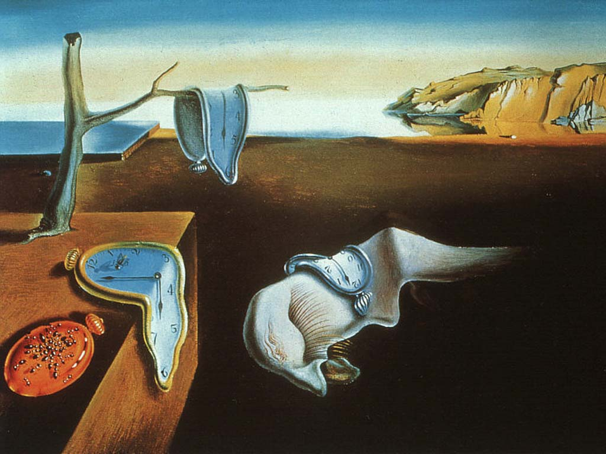

Slide 12
work out (for the best)
to end successfully
A Bitter Pill-A situation or information that is unpleasant but must be accepted.
Ace in the Hole= A hidden or secret strength, or unrevealed advantage.
Achilles’ Hole- A metaphor for a fatal weakness in spite of overall strength.
Add insult to the injury- To further a loss with mockery or indignity; to worsen an unfavorable situation

Slide 13
Thank You !!

